Slide 1
Client Side Scripting
Memory Hoisting

Slide 2


What is Memory Hoisting?
Memory
Hoisting

Slide 3
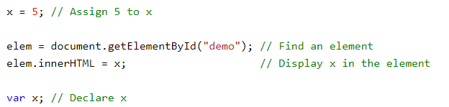
What is Memory Hoisting?
Hoisting is JavaScript's default behaviour of moving declarations to the top.
Unlike other languages, variables can be used before they are declared.

Slide 4
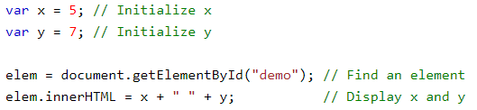
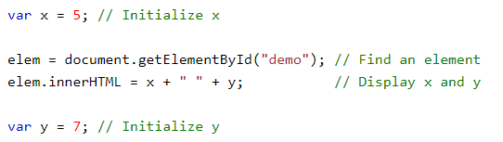
What is Memory Hoisting?
JavaScript only hoists declarations, not initializations.

Slide 5
What is Memory Hoisting?
The JavaScript interpreter is like a chef; first the ingredients are prepared and then they are cooked.
Scripts are not immediately executed, first they are prepared.
Preparation is referred to as the creation stage, where the engine lexically reads through the code:
First it looks for syntax errors.
Then it looks for symbol names. These symbol names are hoisted
During the creation phase, memory pointers are created for variables but they are not initialized.
Once the creation phase is complete, the interpreter goes back to the first line and starts with execution.

Slide 6
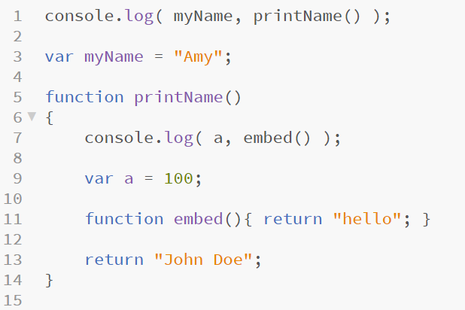

What is Memory Hoisting?

Slide 7
Good Practice
Most developers still get confused on how to properly use Memory Hoisting
It’s ideal to use the convention of declaring variables at the top and initialising variables before using them

